Slide 1
Nutritional Implications of a Colectomy
Cristian Ordoñez
Surgery Rotation Case Presentation
Preceptor: Emily Kula, MS, RDN, LD

Slide 2
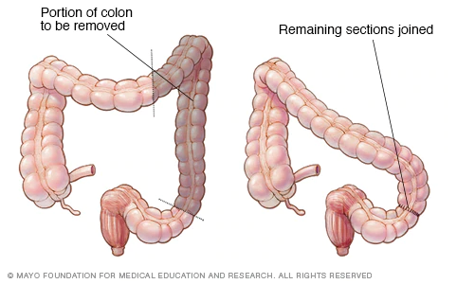
Colectomy
The removal of part of the colon
Most commonly performed to treat colorectal cancer
Other diseases it is used to treat: Ulcerative colitis, Crohn’s disease, complications from diverticulitis

Slide 3
Colectomy (Cont.)
Pre-operation diet:
Similar to colonoscopy
Clear liquids <2 hours before general anesthesia (Grade of recommendation: Strong)
Post-operation diet:
Oral feeding can begin immediately after procedure (Grade of Recommendation: Strong)
Clear liquids → Low residue → Regular
Nutritional implications:
Impaired absorption of fluid/nutrients
Diarrhea, dehydration, offensive odor
Clinical Practice Guidelines for Enhanced Recovery After Colon and Rectal Surgery From the American Society of Colon and Rectal Surgeons and Society of American Gastrointestinal and Endoscopic Surgeons
Notes:
Clinical Practice Guidelines for Enhanced Recovery After Colon and Rectal Surgery From the American Society of Colon and Rectal Surgeons and Society of American Gastrointestinal and Endoscopic Surgeons
American Cancer Society (ACS), US Multi-Society Task Force on Colorectal Cancer, and American College of Radiology

Slide 4
Nutrition Assessment
Chart review:
Presented with bloody stools; colonoscopy revealed adenocarcinoma
Biochemical Data:
Albumin wnl
Ca2+ low
Normocytic anemia
HA1c pre-diabetes range
Anthropometrics:
Age: 44
Height: 5’11
Weight: 320.7 lbs
BMI: 44.2
Target BW adj for Obesity: 211.4 lbs
Subjective:
Informed of pre-diabetes status at Mercy Medical System 3 weeks prior to surgery
1500 kcal restriction
Notes:
Chart review: Per Gen Surg H&P note from 12/2/19: "Mr. XX
is a 44 y/o man with a pmhx of depression PTSD and OSA who as diagnosed with an
adenocarcinoma of his descending colon by colonoscopy. His initial presentation
was abdominal cramping and intermittent bloody stools. He will undergo an open
left hemicolectomy on 12/03/2019"
SUBJECTIVE
Met with Veteran at bedside to obtain subjective data for prior nutrition
assessment. Veteran states he began a 1500 kcal restriction for 3 weeks prior
to admission for surgery which resulted in an intentional 15# wt loss during
this time. This was used in addition to adipex rx from Mercy Medical System to
"get out of pre-diabetic range." No other nutritional concerns were voiced
today.
Energy Requirements: 2400 Kcal/day
Energy calculation is based on: Kcal/Kg, Caloric Factor of 25 and Target Body Wt
Adj for Obesity
Protein Requirements: 105 gm/day NPC:N 106:1
Protein calculation is based on: Target Body Wt Adj for Obesity and protein
level of 1.1
Fluid Requirements: 2400 ml/day or per MD
Weight: Pt current wt is 320.7# w/ no edema present. Per last nutrition note
from 12/3/19 reflecting intentional wt loss: "Weight Hx: Current wt 318.5# and
BMI 43.9 indicating Veteran is obese. Significant wt loss of 18.8#(5.6%) seen in
past 1 month (10/2019-11/2019). Pt wt stable x 3 weeks noting wt range of 314-
318.5#. Current goal is wt maintenance +/- 2-3#; long term goal is wt loss
trending towards BMI of 24.9."
Labs: Alb wnl-may decline 2' med status. Ca2+ is low when adj for alb <4.

Slide 5
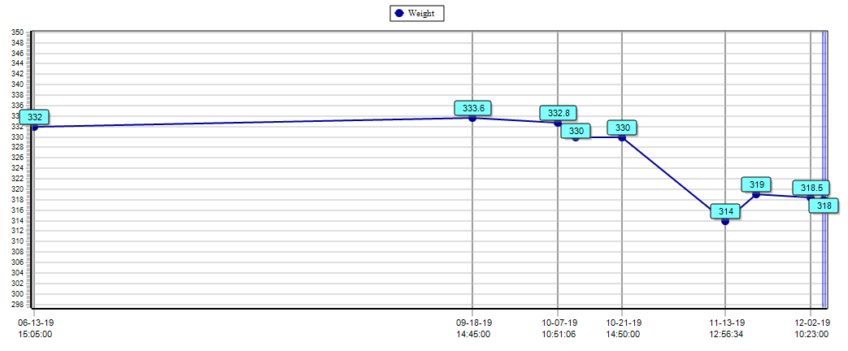
Nutrition Assessment (cont.)
Wt Hx:
Wt loss of 18.8# (5.6%) seen in 1 month (10/2019-11/2019).
Wt stable x 3 weeks range of 314- 318.5#.
Energy Requirements: 2400 kcal/day (kcal factor of 25 % Target BW adj for obesity)
Protein Requirements: 105 gm/day (Protein level of 1.1 & Target BW adj for obesity)
Notes:
Wt hx:
10-07-19 10:51:06 332.8
10-11-19 08:27:00 330
10-21-19 14:50:00 330
11-13-19 12:56:34 314
11-20-19 09:55:11 319
12-02-19 10:23:00 318.5
Current Diet: Clear Liquids
Nutrition Problem: Predicted
Appearance: 44 y/o obese WM
Laboratory Data
Test Result units Ref. range Date
ALBUMIN 3.6 g/dL 3.4 - 5.5 2-Dec-19
C REACTIVE PROTEIN 3.96 mg/L 0.00 - 9.99 28-Sep-18
BUN 14 mg/dL 8 - 20 2-Dec-19
CREATININE 1.1 mg/dL 0.5 - 1.2 2-Dec-19
GLUCOSE 152 H mg/dL 70 - 120 2-Dec-19
HEMOGLOBIN A1C 5.8 H % 3.6 - 5.7 20-Nov-19
POTASSIUM 3.6 mmol/L 3.5 - 5.0 2-Dec-19
PHOSPHORUS 3.6 mg/dL 2.5 - 4.9 2-Dec-19
SODIUM 138 mmol/L 136 - 148 2-Dec-19
CALCIUM 9.1 mg/dL 8.5 - 10.1 2-Dec-19
WBC COUNT 6.10 K/cmm 3.6 - 11.0 2-Dec-19
HGB 13.9 g/dL 13.6 - 17.4 2-Dec-19
HCT 41.5 % 40 - 51 2-Dec-19
MCV 86.1 cmu 80 - 96 2-Dec-19
CHOLESTEROL 164 mg/dL 135 - 200 4-Oct-19
LDL CHOLESTEROL 100 mg/dL 0 - 110 4-Oct-19
HDL CHOLESTEROL 22 L mg/dL 35 - 80 4-Oct-19
TRIGLYCERIDE 319 H mg/dL 0 - 150 4-Oct-19
EGFR (CALCULATED) 73 60 2-Dec-19
LYMPHS % 31.0 % 21 - 51 2-Dec-19
CO2 27 mmol/L 21 - 32 2-Dec-19
MAGNESIUM 2.0 mg/dL 1.8 - 2.4 2-Dec-19
PROTEIN, TOTAL 8.2 g/dL 6.4 - 8.5 1-Nov-19
CHLORIDE 104 mmol/L 98 - 107 2-Dec-19
VITAMIN D (TOTAL) 20 L ng/mL 30 - 75 5-Oct-18
Energy Requirements: 2400 Kcal/day
Energy calculation is based on: Kcal/Kg, Caloric Factor of 25 and Target Body Wt
Adj for Obesity
Protein Requirements: 105 gm/day NPC:N 106:1
Protein calculation is based on: Target Body Wt Adj for Obesity and protein
level of 11

Slide 6
Nutrition Diagnosis
Nutrition Problem: Predicted
Predicted suboptimal energy intake
Related to: 1500 kcal restriction (decreased intake)
As evidenced by: Veteran report, Previous significant wt loss of 5.6% x 1 month

Slide 7
Nutrition Intervention
Meals:
Clear liquid → low residue → regular diet as medically appropriate
Education:
1500 kcal/day is suboptimal
Increased caloric needs post-surgery
Provided RD handout to discuss healthy weight loss
Notes:
Education: Informed Veteran caloric restriction of 1500 kcal/day is suboptimal according to Veteran wt and medical status and rapid wt loss results in greater loss of muscle tissue. Informed Veteran of the body's increased caloric needs post-surgery in order to heal appropriately. Discussed benefits of outpt RD r/t healthy wt loss; Veteran expressed interest and was provided with outpt RD handout;

Slide 8
Nutrition Monitoring & Evaluation
1. PO intake: Adequate PO intake greater than or equal to 75 % meals/supplements
2. Weight: Weight maintenance +/- 2-3# post/op; long term goal of wt loss trending towards BMI of 24.9.

Slide 9
References
Park IJ, Chang GJ. Surgical management of cancer of the colon. Fazio VW, Church JM, Delaney CP, Kiran RP, eds. Current Therapy in Colon and Rectal Surgery. 3rd ed. Philadelphia: Elsevier; 2017. 301-8.
Lee EC, Garrett K. Left colectomy: open and laparoscopic. Evans SRT, ed. Surgical Pitfalls: Prevention and Management. Philadelphia: Saunders Elsevier; 2009. 265-72.
Weiser MR. Left hemicolectomy for treatment of malignancy. Fischer J, ed. Fischer's Mastery of Surgery. 5th ed. Philadelphia: Lippincott Williams & Wilkins; 2012. 162.
Lagares-Garcia JA, Sturrock PR. Left colon: open medial to lateral. Wexner SD, Fleshman JW, eds. Master Techniques in General Surgery: Colon and Rectal Abdominal Operations. Philadelphia: Lippincott Williams & Wilkins; 2012. 59.
1. Gustafsson UO, Scott MJ, Schwenk W, et al.; Enhanced Recovery After Surgery (ERAS) Society, for Perioperative Care; European Society for Clinical Nutrition and Metabolism (ESPEN); International Association for Surgical Metabolism and Nutrition (IASMEN). Guidelines for perioperative care in elective colonic surgery: Enhanced Recovery After Surgery (ERAS(®)) Society recommendations. World J Surg. 2013;37:259–284.
Nygren J, Thacker J, Carli F, et al.; Enhanced Recovery After Surgery Society. Guidelines for perioperative care in elective rectal/pelvic surgery: Enhanced Recovery After Surgery (ERAS®) Society recommendations. Clin Nutr. 2012;31:801–816.
Notes:
American Cancer Society (ACS), US Multi-Society Task Force on Colorectal Cancer, and American College of Radiology

